Slide 1
Tea Leaf Disease Prediction
using XgBoost, KNN & CNN Model
Presented by
Akhil Reddy Maligireddy
Under guidance of
Dr.Chaojie Wang

Slide 2
Introduction
Tea is a crop that has significant economic significance.
It is highly efficient in boosting human immunity, as well as containing a number of useful substances that are necessary for the functioning of the human body, and it performs activities related to medicine and health care.
Tea growers may earn a significant portion of their fortunes via the cultivation of tea plants.
At the moment, the manual approach is the only one that can be used to diagnose illnesses that affect tea leaves.
The majority of tea plants may be found in more harsh highland regions.
Therefore, it is both time-consuming and expensive for specialists to go to the tea estate in order to make a diagnosis.

Slide 3
Objective
Farmers depend on their own personal experiences to differentiate between the many forms of tea illnesses, the findings are very subjective.
The use of machine learning and image processing technology to achieve automatic detection and identification of crop diseases has become an important method for the automatic diagnosis of crop disease as a result of the development of computer technology.
This is because these technologies can detect and identify crop diseases automatically.

Slide 4
Dataset
This tea sickness dataset contains tea leaves showing 7 common diseases of tea:
Red leaf spot
Algal leaf spot
Bird’s eyespot
Gray blight
White spot
Anthracnose
Brown blight
The dataset further contains a class of healthy tea leaves.
Each of the classes contains more than 100 images. The dataset was collected in Johnstone Boiyon farm, Koiwa location, Bomet county from a clone of 1510.
It can be used with transfer learning for Machine learning models for predicting sickness in tea.

Slide 5
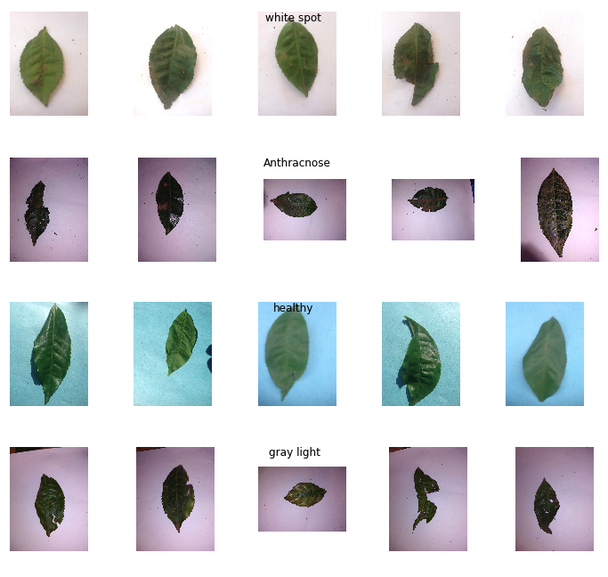
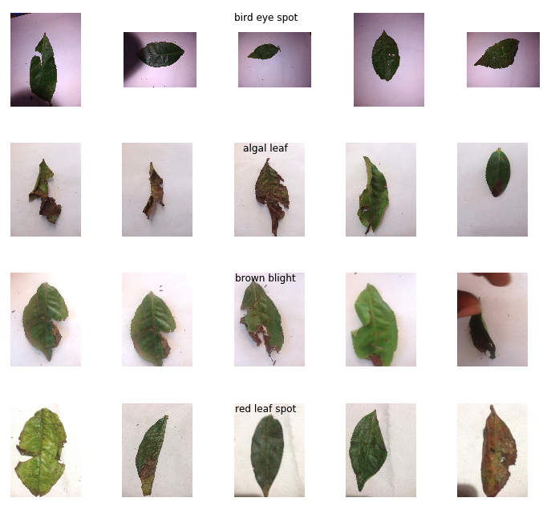
Dataset

Slide 6
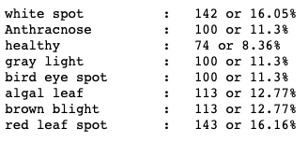
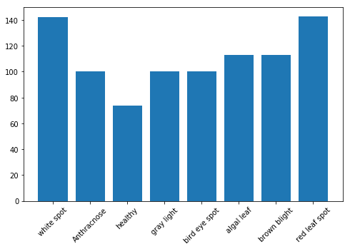
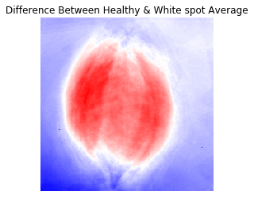
EDA

Slide 7
ML Algorithms
KNN
K-Nearest Neighbour is one of the simplest Machine Learning algorithms based on Supervised Learning technique.
K-NN algorithm assumes the similarity between the new case/data and available cases and put the new case into the category that is most similar to the available categories.
K-NN algorithm stores all the available data and classifies a new data point based on the similarity. This means when new data appears then it can be easily classified into a well suite category by using K- NN algorithm.
K-NN algorithm can be used for Regression as well as for Classification but mostly it is used for the Classification problems.
K-NN is a non-parametric algorithm, which means it does not make any assumption on underlying data.
It is also called a lazy learner algorithm because it does not learn from the training set immediately instead it stores the dataset and at the time of classification, it performs an action on the dataset.
KNN algorithm at the training phase just stores the dataset and when it gets new data, then it classifies that data into a category that is much similar to the new data.

Slide 8
ML Algorithms
XGboost
Considering the massive size of feature vectors and low number of classes, i.e. 10, decided to employed linear XG Boosting classifier known as “Extreme Gradient Boosting”.
It is called “an enhanced gradient boosting library” that makes use of a gradient boosting framework.
But, decision tree-based algorithms are considered to be good performers when it comes to small to medium structured data or tabular data. XGboost is commonly used for supervised learning in machine learning.
Boosting is nothing but ensemble techniques where previous model errors are resolved in the new models. These models are added straight until no other improvement is seen.
One of the best examples of such an algorithm is the AdaBoost algorithm.
Gradient boosting is a method where the new models are created that computes the error in the previous model and then leftover is added to make the final prediction.

Slide 9
CNN
The convolution layer is the core building block of the CNN. It carries the main portion of the network’s computational load.
This layer performs a dot product between two matrices, where one matrix is the set of learnable parameters otherwise known as a kernel, and the other matrix is the restricted portion of the receptive field.
Major concepts of CNN are Max Pooling, Dropout, Flattening.

Slide 10
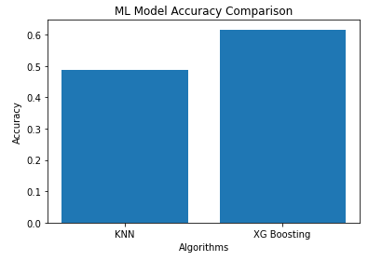
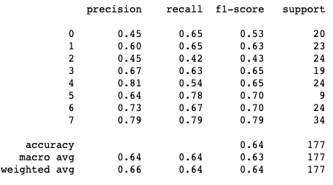
Results

Slide 11
Deployment
Developing a specific web interface to interact with your model.
Streamlit, is an open-source Python library that makes it easy to create and share web apps for machine learning and data science.
It can be extremely useful in presenting progress on a project to your team, gain and share insights to your managers and even get feedback from clients.

Slide 12
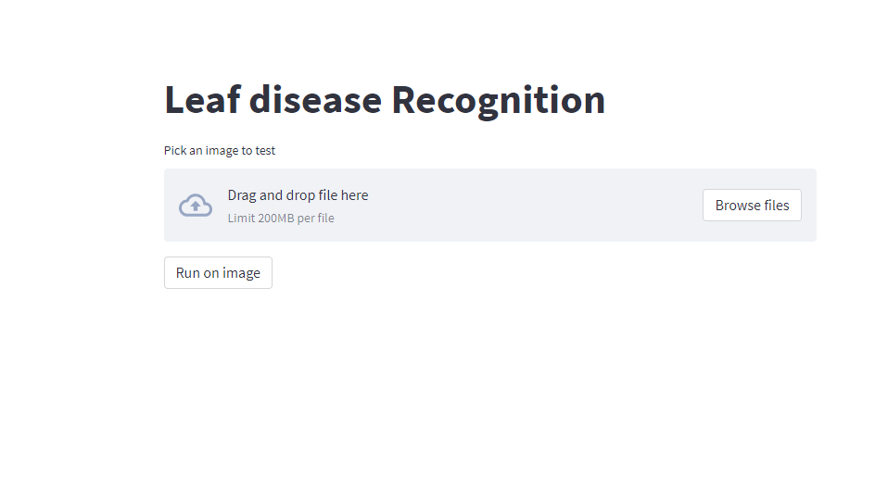
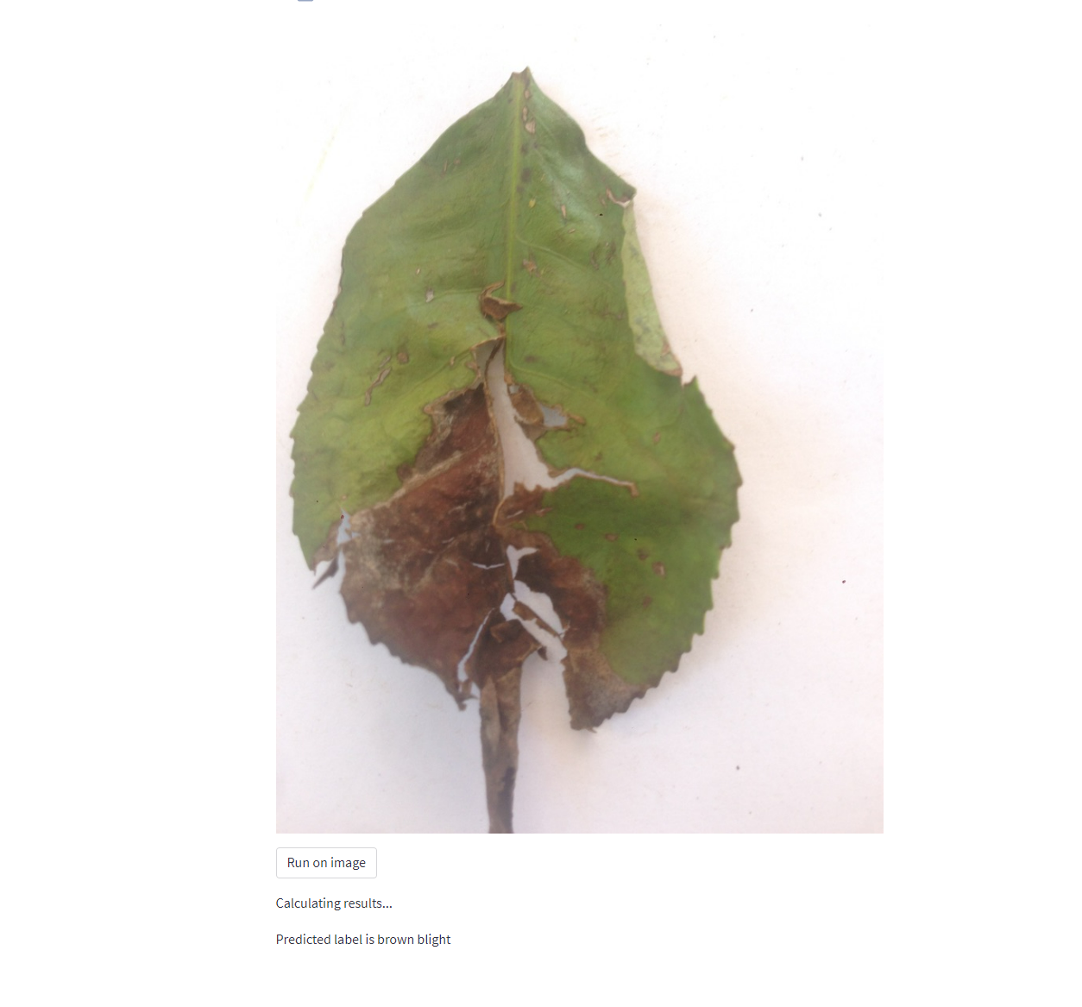
Deployment

Slide 13
Conclusion
From the above-shown accuracy, it is advisable to choose and deploy the
Xgboost model.
Increasing the data volume will help this model perform better.
Accuracy of the proposed model for healthy tea, tea bud blight, tea leaf blight, and tea red scab is 64%.
This model may not be 100% accurate, but working on this model even
further can definitely improve the accuracy by collecting more images.

Slide 14
References:
Pandey, A. K., Sinniah, G. D., Babu, A. K., & Tanti, A. (2021). How the Global Tea Industry Copes up with Fungal Diseases-Challenges and Opportunities. Plant Disease. https://doi.org/10.1094/pdis-09-20-1945-fe .
vikaspedia Domains. (n.d.). Vikaspedia.in. Retrieved June 10, 2022, from https://vikaspedia.in/agriculture/crop-production/integrated-pest-managment/ipm-for-commercial-crops/ipm-strategies-for-tea/tea-diseases
Chauhan, A. (2022, February 6). Make WebApp With Streamlit With Python. The Pythoneers. https://medium.com/pythoneers/make-webapp-with-streamlit-with-python-ecc59e488a5
Rao, A. (2018, November 27). Convolutional Neural Network Tutorial (CNN) – Developing An Image Classifier In Python Using TensorFlow. Edureka; Edureka. https://www.edureka.co/blog/convolutional-neural-network/
https://realpython.com/knn-python/#:~:text=The%20kNN%20algorithm%20is%20a%20supervised%20machine%20learning,Practical%20Guide.%20kNN%20Is%20a%20Nonlinear%20Learning%20Algorithm
Maklin, C. (2020, May 9). XGBoost Python Example. Medium. https://towardsdatascience.com/xgboost-python-example-42777d01001e

